Slide 1

HACKATHON 2025
Etherial
Where Truth is Earned, Not Declared
A Decentralized Consensus Engine for Campus News
Zero-Knowledge Proofs
P2P Consensus
Anonymous
Decentralized Truth Protocol
v1.0

Slide 2
The Crisis
The "Centralized Truth" Paradox
Why current systems fail to protect honest discourse
Censorship
Mob Rule
Arbitrary Content Removal
Democracy Without Wisdom
Admins delete what they don't like. Campus moderators act as gatekeepers, silencing dissenting voices and controversial topics that challenge institutional narratives.
Popular lies outvote unpopular truths on Reddit/Twitter. Viral misinformation spreads faster than facts, and the loudest voices dominate the narrative.
No appeal process exists
Engagement > Accuracy
Sybil Attacks
Fear
Fake Identity Exploitation
Identity Exposure Risk
One student with 50 bot accounts can manipulate the narrative. Without identity verification, coordinated attacks distort community consensus.
Students are afraid to whistleblow because of identity exposure. Real accountability requires anonymity, but current platforms demand real names.
50 fake accounts = 50 votes
Privacy vs. Transparency

Slide 3

The Revolution
The Solution: Etherial
Three pillars of decentralized truth verification
PILLAR 01
PILLAR 02
No Central Server
Blind Authentication
Uses GunDB (P2P Graph Database) for truly decentralized data storage. No single point of failure, no central authority to compromise.
Verify .edu emails without storing them. Zero-Knowledge proof concept ensures one student = one vote, without exposing identity.
Peer-to-Peer
Distributed
Anonymous
Verified
PILLAR 03
Reputation Engine
√Karma
Truth is a function of Karma, not just vote count. Quality contributions earn reputation, creating a self-correcting ecosystem where accuracy is rewarded.
Vote Weight

Slide 4
The Process
How It Works: The "Truth Engine"
Four-step decentralized verification protocol
STEP 01
STEP 02
STEP 03
STEP 04
Post Rumor
Blind Voting
Resolution
Final State
Anonymous submission
with .edu verification
Hidden counts prevent
bandwagon effect
√Karma weighted
consensus algorithm
Fact Locked
or Debunked
Voting Window
Threshold
Challenge
24-48 hours of blind voting before resolution
60% weighted consensus required
Any fact can be disputed later

Slide 5
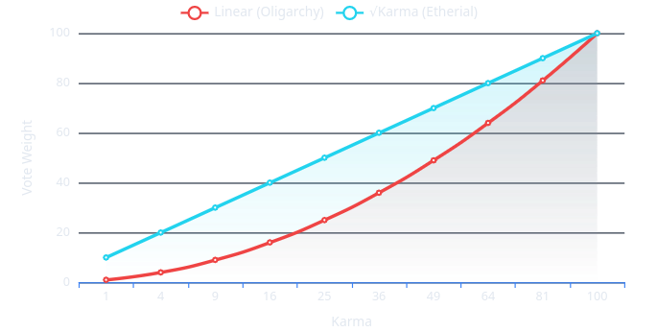
Core Innovation 01
The "Square Root" of Trust
Solving the Oligarchy Problem Through Mathematics
Vote Weight = √Karma
Linear vs Square Root Weighting
New User
1 Karma
1.0×
Active User
25 Karma
5.0×
Veteran
100 Karma
10.0×
Linear
√Karma
Result
100 Karma = 10× power, not 100×
100× power
10× power
Fair consensus
Oligarchy risk
Balanced influence
No monopolies

Slide 6

Core Innovation 02
The "Ghost" & Opposition System
Accountability without censorship, truth over consensus
The Ghost
The Opposition
Mathematical Accountability
Challenge Anytime
Digital Tombstone
Challenge Facts
Deleted rumors aren't erased. They leave a mathematical tombstone that affects related trust scores.
Even a "Fact" can be challenged. If you prove a Fact wrong with evidence, the system reverses the decision.
Reputation Cascade
Slashing Penalty
Users who supported debunked claims see their karma decay over time, creating lasting accountability.
Original voters face heavy karma penalty (slashing). This incentivizes careful verification over bandwagon voting.
Transparency without permanence
Truth > Consensus
Self-Correcting System
∞
-50%
No decision is final. Truth emerges through continuous challenge.
Challenge Window
Max Slash

Slide 7
Technical Stack
System Architecture
Three-layer decentralized stack
LAYER 01
LAYER 02
LAYER 03
Frontend
Backend
Crypto
Next.js
GunDB
SEA
React Framework
P2P Graph Database
Security Layer
Server-side rendering for SEO and performance
Decentralized, offline-first, real-time sync
Security, Encryption, Authorization
Tailwind CSS
DigitalOcean
Packet Signing
Utility-first Styling
Relay Infrastructure
Every Message
Rapid UI development with custom theming
Stateful relay nodes for peer discovery
Cryptographic proof of authorship
Serverless Deployment
Distributed & Stateful
Zero-Trust Security
Data Flow
End-to-End Encrypted
No Central Authority
User → SEA Sign → GunDB Relay → P2P Network

Slide 8
Security Analysis
Mathematical Proof of Resilience
Attack cost analysis and system security guarantees
Attack Threshold Formula
Real-World Example
m × √ka ≥ 1.5 × n × √kh
Honest Participants
n = 50
Avg Karma
kh = 100
Attacker Variables
Honest Variables
m
# of fake accounts
n
# of honest users
Required Attackers
m ≥ 375
ka
Avg karma/attacker
kh
Avg karma/honest
Verified Emails Needed
375+ .edu
Attack Cost Analysis
Per .edu email value
$50-200
The 1.5× multiplier represents the 60% consensus threshold
Total attack cost
$18,750+
Detection probability
>95%
Security Guarantee
7.5:1
Economic infeasibility of large-scale attacks
Attacker:Honest Ratio

Slide 9

Vision
Impact & Future
From campus to the world: The roadmap to decentralized truth
01
Phase 1
02
Phase 2
03
Phase 3
Campus Launch
Domain Sharding
Global Scale
Campus Deployment
Multi-University Network
Beyond Academia
Launch at 3 pilot universities. Self-correcting community notes replace traditional moderation.
Expansion to 50+ universities. Cross-domain reputation portability while maintaining isolation.
The future of decentralized news. Expand to corporate, government, and civic contexts.
Success Metrics
Network Effects
Vision Metrics
10K+
85%
500K+
25
10M+
100+
Active Users
Accuracy Rate
Total Users
Universities
Global Users
Communities
Q2 2025
Q4 2025
2026+
The Ultimate Vision
Trustless
Transparent
Decentralized
A world where truth is determined by evidence, not authority

Slide 10

HACKATHON 2025
Ethereal
Where Truth is Earned, Not Declared
Join the decentralized revolution. Help us build a world where information is verified by the community, not controlled by the few.
Open Source
Community
Website
gh/exeNyx7/ethereal
discord.gg/etherial
etherial.network
Zero-Knowledge Proofs
P2P Consensus
Anonymous

